Slide 1

Traffic Lights
GREEN — Keep going! YELLOW — Proceed Slowly RED — Stop!

Slide 2
Recursion
TIP102
Week 7
Notes:
🌟 Purpose: Welcome students and introduce the session's focus on recursion.
✅ What should I be doing?
Greet students warmly and set a positive tone for the session.
🎙 What should I be saying?
Welcome to Week 7 of TIP102! Today, we’re diving into recursion, one of the most powerful tools in programming.
🙌🏽 How should I engage students?
Use humor or compliments: "Let’s see those bright smiles! Who’s ready for recursion today?"

Slide 3
1 | Welcome 👋🏽 | 0:00 - 0:10
2 | Recursion | 0:10 - 0:45
3 | BREAK | 0:45 - 0:50
4 | Collaborative Problem Solving | 0:50 - 1:50
5 | Wrap Up | 1:50 - 2:00
Notes:
🌟 Purpose: Provide an overview of the session structure and timing.
✅ What should I be doing?
Walk through the agenda to set expectations for the session.
🎙 What should I be saying?
Here’s what we’ll be covering today. We’ll start with an introduction to recursion and work through some examples. After a short break, we’ll dive into collaborative problem solving before wrapping up with reflections and reminders.
The goal is to ensure that by the end of today, you’ll have a solid understanding of how recursion works and where it can be applied.
🙌🏽 How should I engage students?
Ask: "Does anyone have any questions about today’s agenda or what we’ll be focusing on?"
Encourage: "If there’s anything specific you’d like to cover, let me know, and we’ll make sure to address it."

Slide 4
Welcome! 👋🏽
10 minutes

Slide 5


Turn on your cameras
Fill out the entry ticket
Notes:
🌟 Purpose: Encourage visual engagement to foster connection during the session.
✅ What should I be doing?
Prompt students to enable their cameras and submit the entry ticket.
🎙️ What should I be saying?
Let’s kick off our session by turning on our cameras!
Also, don’t forget to fill out the entry ticket to help us organize breakout rooms later.
🙌🏽 How should I engage students?
Use humor or compliments: "Let’s see those smiles!"
Acknowledge and thank students who turn on their cameras.

Slide 6
5 minutes
If you had to answer the same interview question on repeat, which one would you hope it is — and why?
Notes:
Encourages students to think about their strengths or favorite topics in a fun way. Bonus: it warms them up for technical discussions without pressure.

Slide 7
Mock interview
Mock interview too short
Maybe we can have shorter breakout session next time
Notes:
🌟 Purpose: Share feedback from the previous session and highlight areas of success and improvement.
✅ What should I be doing?
Summarize feedback from the previous session's survey and present key takeaways.
🎙️ What should I be saying?
From your feedback, it seems many of you enjoyed [highlighted aspect]. One suggestion was [area for improvement]. We’ll work on that today.
🙌🏽 How should I engage students?
Ask: "Does anyone have additional feedback or suggestions?"

Slide 8

Announcements + Reminders
Recording happening in breakout rooms this and next week!
Videos will be used for TF training purposes, and also to share with students in future class for insights on what strong collaboration looks like
If you’re uncomfortable with recording, you can opt-out by telling your TF not to record (it would only take 1 student to say no for us to not record!)
If you consent to recording, you don’t have to be “perfect”! We want a realistic representation of what our breakout rooms look like!

Slide 9
Recursion
35 minutes

Slide 10
Recursion is the ✨extra✨ twin of iterative.
Why recursive?
Easier to read (for certain problems)
Natural fit for some data structures
Cleaner for divide and conquer algorithms
Less manual state management
Great for backtracking problems
Notes:
🌟 Purpose: Introduce recursion as a concept and explain its key components.
✅ What should I be doing?
Define recursion and explain the difference between the base case and the recursive case.
🎙 What should I be saying?
Recursion is when a method calls itself to solve smaller instances of the same problem. It’s like breaking a big problem into smaller, manageable chunks.
There are two key parts to any recursive function: the base case, which stops the recursion, and the recursive case, where the function calls itself.
🙌🏽 How should I engage students?
Ask: "Can anyone share an example of where they’ve seen recursion used before, even if it’s just conceptually?"

Slide 11
Recursion is a natural fit for more complex data structures — aka, the rest of this class 😄.
With simple, flat structures like arrays or lists, iteration works fine. But as we start working with more nested or branching structures — like trees, graphs, or 2D arrays — things get trickier.
You can think of these structures like mazes or branching paths, where you have to explore deeply, then backtrack. This is where recursion shines:
It automatically uses the call stack to keep track of where you’ve been.
That means you don’t have to manually manage every step or state — recursion does it for you.
In short: recursion lets you explore complex structures without extra bookkeeping.
Notes:
🌟 Purpose: Introduce recursion as a concept and explain its key components.
✅ What should I be doing?
Define recursion and explain the difference between the base case and the recursive case.
🎙 What should I be saying?
Recursion is when a method calls itself to solve smaller instances of the same problem. It’s like breaking a big problem into smaller, manageable chunks.
There are two key parts to any recursive function: the base case, which stops the recursion, and the recursive case, where the function calls itself.
🙌🏽 How should I engage students?
Ask: "Can anyone share an example of where they’ve seen recursion used before, even if it’s just conceptually?"

Slide 12
Recursion is when a method calls itself.
The base case is the instance where a recursive method will return a value rather than calling itself.
def recursive_sum(num):
if num <= 1:
return num
return num + recursive_sum(num - 1)
# Example usage
result = recursive_sum(5)
print(result) # Output will be 15
The recursive case is the instance where the recursive method calls itself.
Notes:
🌟 Purpose: Introduce recursion as a concept and explain its key components.
✅ What should I be doing?
Define recursion and explain the difference between the base case and the recursive case.
🎙 What should I be saying?
Recursion is when a method calls itself to solve smaller instances of the same problem. It’s like breaking a big problem into smaller, manageable chunks.
There are two key parts to any recursive function: the base case, which stops the recursion, and the recursive case, where the function calls itself.
🙌🏽 How should I engage students?
Ask: "Can anyone share an example of where they’ve seen recursion used before, even if it’s just conceptually?"

Slide 13
def recursive_sum(num):
if num <= 1:
return num
return num + recursive_sum(num - 1)
The base case comes from the part of the iterative method that stops the repetition. It occurs when a certain condition is met.
def iterative_sum_while(num):
total = 0
while num > 0:
total += num
num -= 1
return total
Notes:
🌟 Purpose: Explain the base case and its importance in recursion.
✅ What should I be doing?
Highlight the base case in the example provided and explain its role.
🎙 What should I be saying?
The base case is the condition that ends the recursion. Without a base case, the function would call itself indefinitely, leading to a stack overflow error.
In our example, the base case is when num <= 1. At this point, the function simply returns the value without making another recursive call.
🙌🏽 How should I engage students?
Ask: "Why do you think it’s critical to have a base case? What might happen if we forget to include one?"

Slide 14
def recursive_sum(num):
if num <= 1:
return num
return num + recursive_sum(num - 1)
The recursive case from from the part of the iterative method that repeats.
def iterative_sum_while(num):
total = 0
while num > 0:
total += num
num -= 1
return total
Notes:
🌟 Purpose: Explain the recursive case and how it enables the function to solve the problem.
✅ What should I be doing?
Walk through the recursive case in the example provided.
🎙 What should I be saying?
The recursive case is where the function calls itself to solve a smaller part of the problem. In our example, num + recursive_sum(num - 1) keeps reducing num until it reaches the base case.
This repeated calling and combining of results is what makes recursion so powerful.
🙌🏽 How should I engage students?
Ask: "What do you think happens to the function’s state as it keeps calling itself? How does it ‘remember’ what to return?"

Slide 15
The recursive call has its own set of local variables, including the formal parameters.
def recursive_sum(num):
if num <= 1:
return num
return num + recursive_sum(num - 1)
# Example usage
result = recursive_sum(5)
print(result) # Output will be 15
The parameter values capture the progress of a recursive process, just like how loop control variables capture the progress of a loop.
Notes:
🌟 Purpose: Explain how recursion progresses by using local variables and formal parameters to keep track of the state of each recursive call.
✅ What should I be doing?
Walk through the example code, emphasizing how each recursive call creates its own copy of local variables.
Highlight the significance of the parameter num in tracking the progress of the recursion.
🎙 What should I be saying?
In recursion, each call to the function creates its own set of local variables, including the formal parameters. These variables are unique to each function call and help the recursion progress.
Here’s an example function, recursive_sum, which calculates the sum of numbers from num down to 1. The base case is if num <= 1, where the function stops and returns the value of num.
In the recursive case, the function returns num + recursive_sum(num - 1). Each call decreases the value of num by 1, capturing the progress of the recursion, just like how loop control variables track the progress in an iterative approach.
For example, if we call recursive_sum(5), the first call will handle num = 5, the second call will handle num = 4, and so on until num = 1, where the recursion ends.
The output of recursive_sum(5) is 5 + 4 + 3 + 2 + 1, which equals 15.
🙌🏽 How should I engage students?
Ask: "Can you see the connection between recursion and a loop? How does the parameter num function like a loop counter?"
Encourage: "Let’s trace this example on the board or in Python Tutor. What do you think happens after the base case is reached? How do the recursive calls resolve?"
Challenge: "What would happen if we forgot to include the base case? Why is it so critical to avoid infinite recursion?"

Slide 16
Why Recursion?
Sometimes, it's simpler than the iterative approach, where you divide and conquer.
Sorting or binary search (divide and conquer)
Permutations and combinations
Tree/graph traversal
Notes:
🌟 Purpose: Highlight scenarios where recursion is a useful tool.
✅ What should I be doing?
Explain when recursion is simpler or more efficient than iteration.
🎙 What should I be saying?
Recursion is especially useful for problems like divide-and-conquer, tree traversal, or generating permutations and combinations. These problems are naturally recursive and often simpler to solve with recursion than with loops.
For example, binary search is a divide-and-conquer algorithm that benefits greatly from recursion.
🙌🏽 How should I engage students?
Ask: "Can you think of a problem where recursion might make the solution simpler or more elegant?"

Slide 17
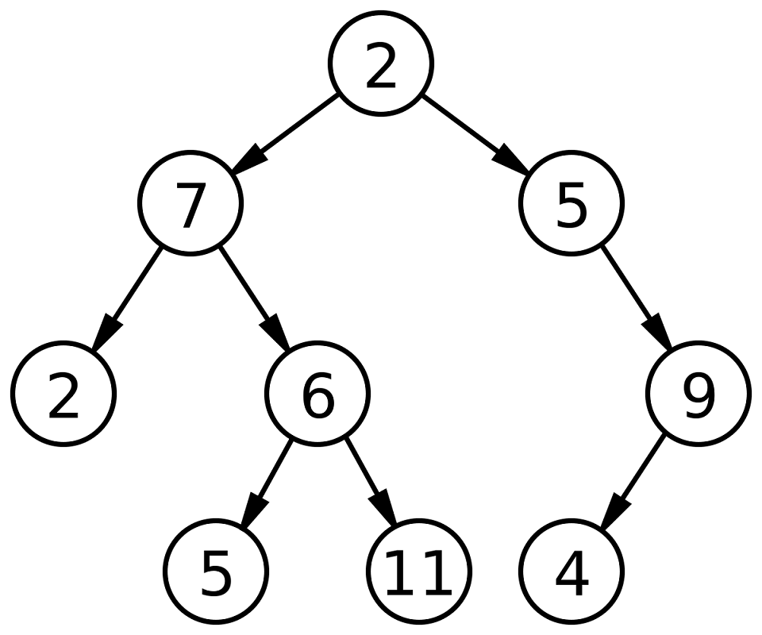
Binary tree (coming next week)
Notes:
🌟 Purpose: Provide a preview of the next week's topic on binary trees, sparking curiosity and preparing students for the upcoming lesson.
How do you think we could leverage recursion to manage this DS?
✅ What should I be doing?
Briefly introduce binary trees and their importance in computer science.
Set the stage for next week’s session by explaining what students can expect to learn.
🎙 What should I be saying?
Next week, we’ll dive into binary trees, an essential data structure in computer science. Binary trees are used in various applications, such as searching, sorting, and organizing hierarchical data.
Each node in a binary tree has at most two children: a left child and a right child. This structure allows us to efficiently traverse and manipulate data.
For example, the tree shown here starts with the root node, 2, and branches into left and right subtrees. We’ll learn how to traverse trees, search for elements, and more.
This is a foundational topic that builds on our understanding of recursion and sets the stage for more advanced algorithms.
🙌🏽 How should I engage students?
Ask: "Looking at this tree, what do you notice about the structure? Why do you think binary trees might be useful in solving real-world problems?"
Encourage: "If you’re curious, think about how recursion might be applied to traverse this structure. Can you imagine calling a function recursively on the left and right children of a node?"
Build excitement: "Next week, we’ll also see how binary trees relate to practical applications like searching data faster than with a simple list."

Slide 18
Print binary tree (recursive)
def print_tree(node):
if node:
print(node.value)
print_tree(node.left)
print_tree(node.right)
POLL: we can use the same space complexity for iterative
True
False
Messed up on this! The class is right where the recursive stack will use same space as a iterative stack!
Notes:
🌟 Purpose: Introduce a recursive method for traversing and printing a binary tree.
✅ What should I be doing?
Walk students through the recursive function print_tree.
Explain how the function uses recursion to traverse the tree in a pre-order traversal (root, left, right).
🎙 What should I be saying?
This example shows a recursive function to print the nodes of a binary tree. The method performs a pre-order traversal, where we visit the root node first, then recursively traverse the left subtree, followed by the right subtree.
The function takes a node as input. If the node exists, we first print its value. Then, we recursively call print_tree on the left child, and after that, on the right child.
In this tree, the traversal order would be 2, 7, 2, 6, 5, 11, 5, 9, 4.
Notice how the function calls itself for each child node. This demonstrates the power of recursion in working with hierarchical data structures like trees.
🙌🏽 How should I engage students?
Ask: "Looking at the function, can you identify the base case and the recursive case? Why are both essential for recursion to work?"
Encourage: "What do you think will happen if the tree is empty or if there’s only one node? Try visualizing this process."
Challenge: "Can you think of scenarios where recursion might not be the best choice for tree traversal?"

Slide 19
Print binary tree (iterative)
def print_tree(root):
stack = []
current = root
while stack or current:
while current:
stack.append(current)
current = current.left
current = stack.pop()
print(current.value)
current = current.right
Notes:
🌟 Purpose: Introduce an iterative method for traversing and printing a binary tree.
✅ What should I be doing?
Explain how the iterative approach uses a stack to simulate the recursion process.
Compare this approach to the recursive method from the previous slide.
🎙 What should I be saying?
This example shows an iterative way to traverse and print a binary tree. It uses a stack to simulate the recursion process.
We start by initializing an empty stack and setting the current node to the root. While there are still nodes to process in the stack or the current node isn’t null, we follow these steps:
First, we traverse to the leftmost node, pushing each visited node onto the stack.
When we can’t go left anymore, we pop a node from the stack, print its value, and then move to its right child.
This iterative approach achieves the same pre-order traversal as the recursive method, but without the risk of running out of stack space for deep trees.
🙌🏽 How should I engage students?
Ask: "Why do we use a stack in this method? How does it simulate the recursive call stack?"
Compare: "What are the advantages of using an iterative method over recursion for tree traversal? Can you think of any trade-offs?"
Encourage: "If you were to write a similar iterative function for post-order traversal, what changes would you need to make?"

Slide 20
Traffic Lights
GREEN — Keep going! YELLOW — Proceed Slowly RED — Stop!

Slide 21
Why Not Recursion?
It's confusing!
Iterative solutions are usually easier to understand and debug.
Notes:
🌟 Purpose: Discuss the limitations and challenges of recursion.
✅ What should I be doing?
Explain why recursion can be confusing or less practical in some cases.
🎙 What should I be saying?
While recursion is powerful, it can also be confusing. Tracing recursive calls and debugging recursive functions is often harder than working with iterative solutions.
In practice, recursion is more commonly used to test conceptual understanding in interviews rather than in production code, where iterative solutions are usually preferred for clarity.
🙌🏽 How should I engage students?
Ask: "What challenges have you faced when working with recursion? How did you overcome them?"

Slide 22
When to use iterative vs recursive?
Recursive does not always mean better
Recursive solutions can be elegant, but not always the most efficient.
Stack overflow, extra memory usage, and slower performance can be drawbacks.
Data structures that generally have a recursive approach
Trees
Graphs
2D arrays
Techniques that generally have a recursive approach
Divide and conquer
Backtracking
Notes:
🌟 Purpose: Discuss the limitations and challenges of recursion.
✅ What should I be doing?
Explain why recursion can be confusing or less practical in some cases.
🎙 What should I be saying?
While recursion is powerful, it can also be confusing. Tracing recursive calls and debugging recursive functions is often harder than working with iterative solutions.
In practice, recursion is more commonly used to test conceptual understanding in interviews rather than in production code, where iterative solutions are usually preferred for clarity.
🙌🏽 How should I engage students?
Ask: "What challenges have you faced when working with recursion? How did you overcome them?"

Slide 23
Example: Factorial DEMO
Implement a method to calculate the factorial:
5! = 5 * 4 * 3 * 2 * 1
4! = 4 * 3 * 2 * 1
3! = 3 * 2 * 1
2! = 2 * 1
1! = 1
Notes:
🌟 Purpose: Introduce the factorial function as a simple example of recursion.
✅ What should I be doing?
Explain the factorial concept and why it’s a natural fit for recursion.
Walk students through how a recursive method can calculate the factorial.
🎙 What should I be saying?
Let’s look at an example of recursion: calculating the factorial of a number. The factorial of a number n, written as n!, is the product of all integers from 1 up to n.
For example, 5! = 5 * 4 * 3 * 2 * 1, which equals 120.
This problem is naturally recursive because we can break it down into smaller subproblems. For instance, 5! can be expressed as 5 * 4!, and 4! can be expressed as 4 * 3!, and so on.
The base case here is 1! = 1. Once we reach this point, the recursion stops, and the function returns the value 1.
🙌🏽 How should I engage students?
Ask: "Can anyone identify the base case and the recursive case in this example?"
Encourage: "Let’s think about what happens if we accidentally leave out the base case. What would happen to the function?"
Challenge: "If we were to implement this iteratively instead of recursively, how would the approach differ? Which do you think is more efficient for this specific problem?"

Slide 24
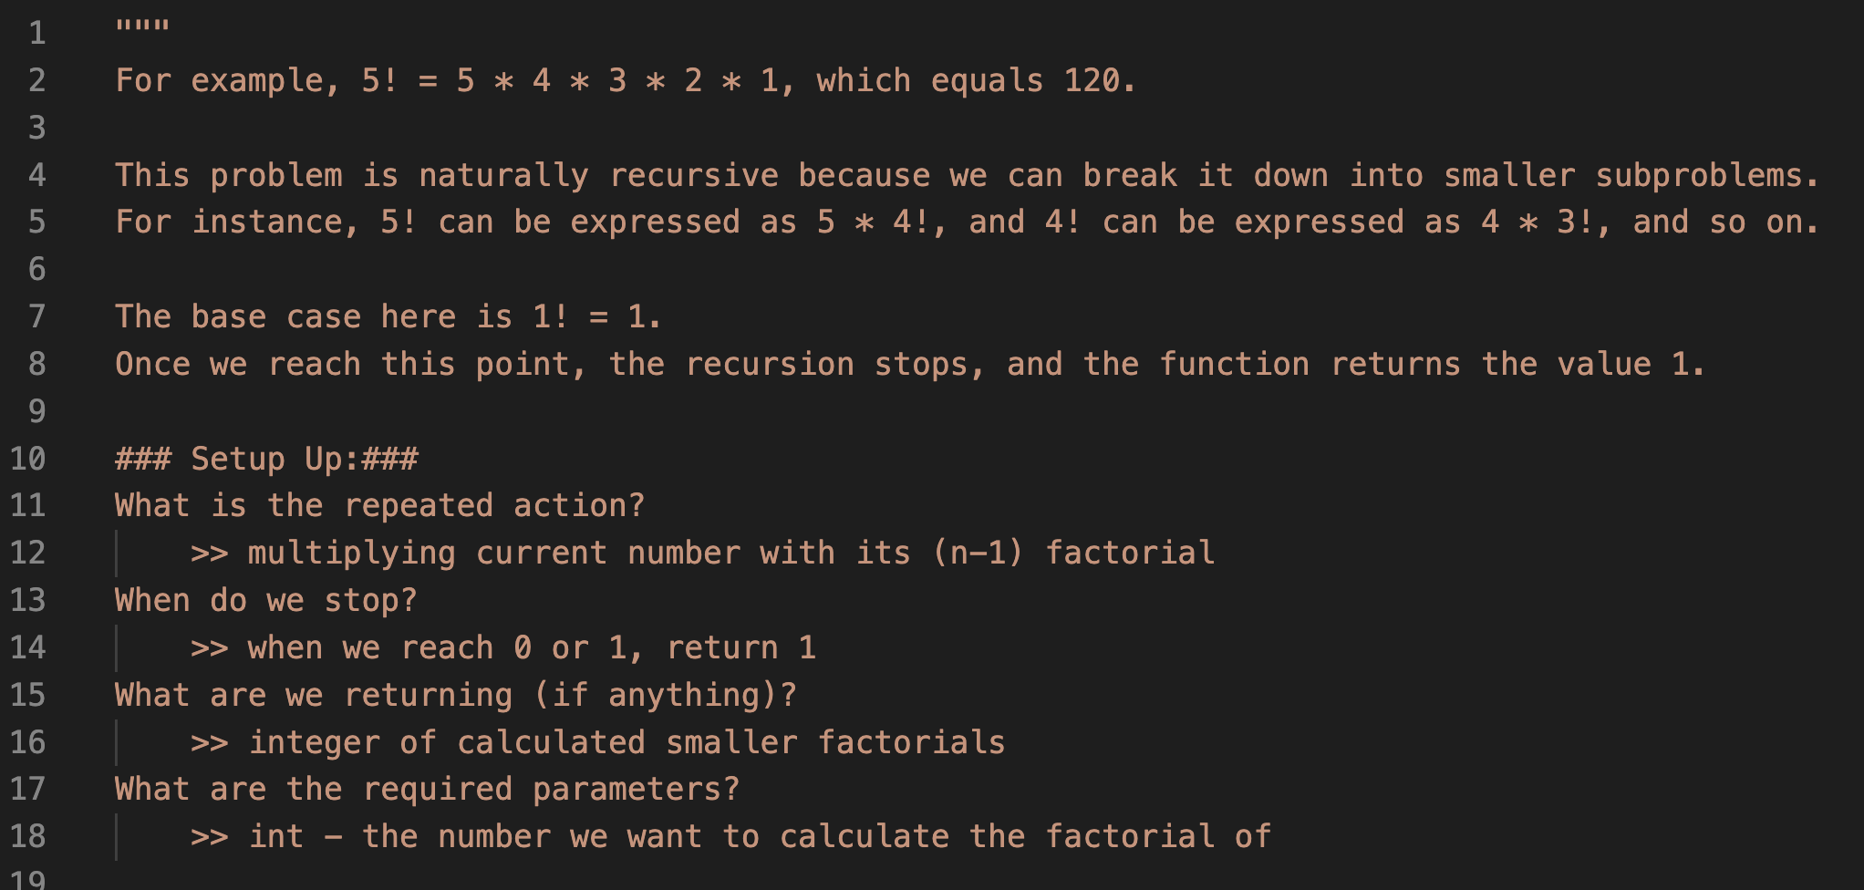
Example: Factorial DEMO
Notes:
🌟 Purpose: Introduce the factorial function as a simple example of recursion.
✅ What should I be doing?
Explain the factorial concept and why it’s a natural fit for recursion.
Walk students through how a recursive method can calculate the factorial.
🎙 What should I be saying?
Let’s look at an example of recursion: calculating the factorial of a number. The factorial of a number n, written as n!, is the product of all integers from 1 up to n.
For example, 5! = 5 * 4 * 3 * 2 * 1, which equals 120.
This problem is naturally recursive because we can break it down into smaller subproblems. For instance, 5! can be expressed as 5 * 4!, and 4! can be expressed as 4 * 3!, and so on.
The base case here is 1! = 1. Once we reach this point, the recursion stops, and the function returns the value 1.
🙌🏽 How should I engage students?
Ask: "Can anyone identify the base case and the recursive case in this example?"
Encourage: "Let’s think about what happens if we accidentally leave out the base case. What would happen to the function?"
Challenge: "If we were to implement this iteratively instead of recursively, how would the approach differ? Which do you think is more efficient for this specific problem?"

Slide 25
def factorial(n):
if n == 1:
return 1
else:
return n * factorial(n - 1)
factorial(5)
return 5 * factorial(4)
5 * 24 = 120
factorial(4)
return 4 * factorial(3)
4 * 6 = 24
What is the result of factorial(5)?
factorial(3)
return 3 * factorial(2)
3 * 2 = 6
120
factorial(2)
return 2 * factorial(1)
2 * 1 = 2
factorial(1)
return 1
Notes:
🌟 Purpose: Demonstrate a real-world example of recursion using the factorial function.
✅ What should I be doing?
Walk through the implementation of the factorial function and trace its recursive calls.
🎙 What should I be saying?
Here’s a classic example of recursion: calculating the factorial of a number. The factorial of n is defined as n * (n-1) * (n-2) ... * 1.
Using recursion, we define factorial(n) as n * factorial(n-1) with the base case being factorial(1) = 1.
Let’s trace the function calls step by step to see how the recursive calls stack and resolve.
🙌🏽 How should I engage students?
Ask: "Can you identify the base case and recursive case in this function? Why is each important?"

Slide 26
POLL: what if we removed the “else:” (return n*factorial(n-1) remains with proper indentation)?
The function will throw a syntax error.
The function will no longer return the correct result.
The function will still work correctly and return the expected factorial.
The function will enter an infinite loop and crash.
def factorial(n):
if n == 1:
return 1
else:
return n * factorial(n - 1)
Notes:
🌟 Purpose: Demonstrate a real-world example of recursion using the factorial function.
✅ What should I be doing?
Walk through the implementation of the factorial function and trace its recursive calls.
🎙 What should I be saying?
Here’s a classic example of recursion: calculating the factorial of a number. The factorial of n is defined as n * (n-1) * (n-2) ... * 1.
Using recursion, we define factorial(n) as n * factorial(n-1) with the base case being factorial(1) = 1.
Let’s trace the function calls step by step to see how the recursive calls stack and resolve.
🙌🏽 How should I engage students?
Ask: "Can you identify the base case and recursive case in this function? Why is each important?"

Slide 27
Recursion Questions To Get Started
What part of the problem is being repeated in each step?
This helps define the recursive case — what the function keeps doing.
What is the simplest version of the problem where we already know the answer?
This defines the base case — a condition that prevents infinite recursion.
What value do we need from each smaller subproblem to build the final answer?
Helps clarify whether the recursion is used for processing or calculating, and what needs to be returned.
What information/parameter do we need to solve the problem
Identifies the function arguments — what input is required for each recursive call to work correctly and eventually reach the base case.

Slide 28
Recursion (in more words)
Recursion repeats the same workload over and over again
Each workload depends on another
Also keeps track of some sort of order naturally
Each part solves a smaller piece of the whole
A recursive function trusts that the smaller call will give the right result — it just focuses on solving this layer.
Sometimes we just do something, other times we return something
Use recursion for actions (like printing or modifying) — no return needed
Use recursion for calculations (like sum, factorial) — return values that build the final answer

Slide 29

Break Time!
Take 5 mins to step away from the computer. Feel free to turn off your camera and return promptly after 5 mins.
Notes:
🌟 Purpose: Provide a short break to refresh and re-energize.
✅ What should I be doing?
Announce the break and remind students to return on time.
Play the countdown timer video (be sure to share sound).
🎙️ What should I be saying?
Let’s take 5 minutes to step away from the screen. Be sure to return promptly.

Slide 30
Collaborative Problem Solving
60 minutes

Slide 31
60 minutes
🏃🏽 Navigate to your breakout room.
👋🏽 Introduce yourselves!
🧑🏽‍💻 Work on the problems for your selected unit.

Slide 32
Wrap Up
10 minutes

Slide 33
Notes:
🌟 Purpose: End the session on a positive note.
✅ What should I be doing?
Prompt students to share their reflections in the chat.
🎙️ What should I be saying?
Let’s celebrate your wins. Share one good thing you learned or accomplished today!
🙌🏽 How should I engage students?
Read a few responses aloud and celebrate with enthusiasm.

Slide 34
Binary Search - Activity
The binary search algorithm finds a target element in a sorted list by dividing the list in half in each iteration.
60
5
10
0
60
5
10
0
20
1
20
1
30
2
30
2
40
3
50
4
50
4
low
mid
low
mid
mid
high
Target: 40
Notes:
🌟 Purpose: Introduce binary search as an example of recursion in action.
✅ What should I be doing?
Explain the recursive nature of binary search and walk through the function.
🎙 What should I be saying?
Binary search is a classic example of recursion. It works by dividing a sorted array into halves and searching in the relevant half.
The recursive case involves checking whether the middle element is the target, and if not, calling the function on either the left or right half of the array.
🙌🏽 How should I engage students?
Ask: "Why is binary search more efficient than linear search? How does recursion simplify its implementation?"

Slide 35
POLL 1
What should a base case check be for in a recursive binary search?
A) Whether the list is sorted B) Whether the middle element equals the target C) Whether the list has more than 10 items D) Whether the target is negative

Slide 36
POLL 2
When do we stop searching in recursive binary search?
A) When the left index equals the middle index B) When the list is reversed C) When the left index goes past the right index D) When the target is greater than the middle

Slide 37
POLL 3
What parameters should a recursive binary search function usually include?
A) The array only B) The array, the target, and current index C) The array, the target, left index, and right index D) Only the left and right index

Slide 38
POLL 3
What value should be returned if the target is found?
A) True B) left C) -1
D) The index of the middle element

Slide 39
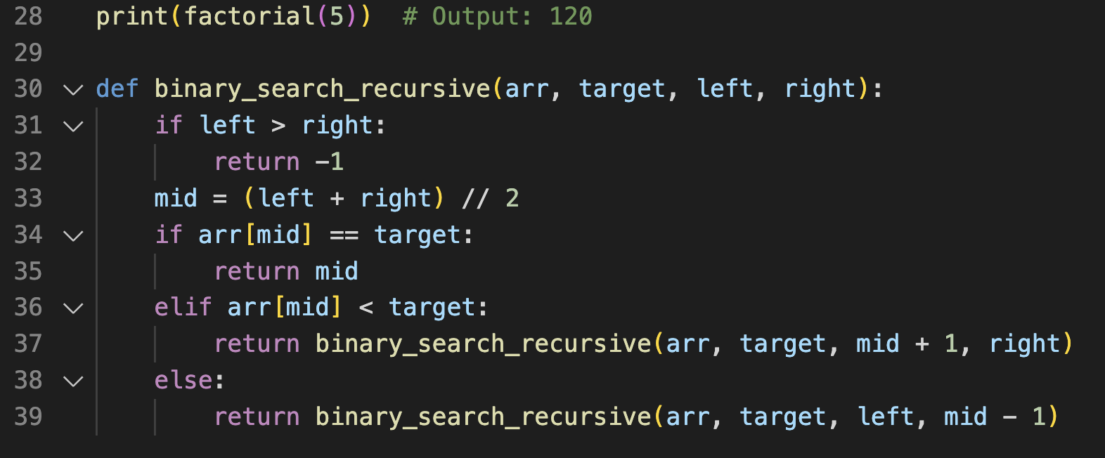
parameters
base cases
recursive calls

Slide 40


Session Survey Time!
Notes:
🌟 Purpose: Gather feedback to improve future sessions.
✅ What should I be doing?
Share the survey link and emphasize its importance.
🎙️ What should I be saying?
Your feedback helps us make these sessions even better. Please take a moment to complete the survey.
🙌🏽 How should I engage students?
Thank students for their input and explain how feedback has been used in the past.

Slide 41
Print binary tree (recursive)
def print_tree(node):
if node:
print(node.value)
print_tree(node.left)
print_tree(node.right)
POLL: we can use the same space complexity for iterative
True
False
Messed up on this! The class is right where the recursive stack will use same space as a iterative stack!
Notes:
🌟 Purpose: Introduce a recursive method for traversing and printing a binary tree.
✅ What should I be doing?
Walk students through the recursive function print_tree.
Explain how the function uses recursion to traverse the tree in a pre-order traversal (root, left, right).
🎙 What should I be saying?
This example shows a recursive function to print the nodes of a binary tree. The method performs a pre-order traversal, where we visit the root node first, then recursively traverse the left subtree, followed by the right subtree.
The function takes a node as input. If the node exists, we first print its value. Then, we recursively call print_tree on the left child, and after that, on the right child.
In this tree, the traversal order would be 2, 7, 2, 6, 5, 11, 5, 9, 4.
Notice how the function calls itself for each child node. This demonstrates the power of recursion in working with hierarchical data structures like trees.
🙌🏽 How should I engage students?
Ask: "Looking at the function, can you identify the base case and the recursive case? Why are both essential for recursion to work?"
Encourage: "What do you think will happen if the tree is empty or if there’s only one node? Try visualizing this process."
Challenge: "Can you think of scenarios where recursion might not be the best choice for tree traversal?"

Slide 42

Final Reminders
Finish the problem sets for additional practice
Take the weekly HackerRank assessment by Sunday @ midnight
Note to self: stress test the polls
Notes:
🌟 Purpose: Provide a short break to refresh and re-energize.
✅ What should I be doing?
Announce the break and remind students to return on time.
Play the countdown timer video (be sure to share sound).
🎙️ What should I be saying?
Let’s take 5 minutes to step away from the screen. Be sure to return promptly.

